Slide 1
Match Maker
Mesh Parameterization, partioning and Texture Mapping
Qiao C. Chaucey L. Chong G
Apr 2016, Simon Fraser University

Slide 2
Outline
Project Overview and Work Flow
2.Some interesting algorithms
- Tutte Embedding
- Triangualtion
- Floodfill (original)
- Texture Mapping
3.Optimization
- Optimizations we did
- Possible Futural Optimizations
4.A Demo

Slide 3
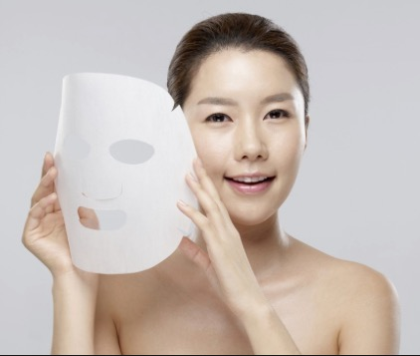
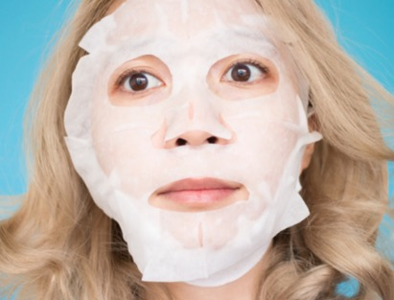
Project Overview and Work Flow ----------------------------------------------------------------------
Intuition
Map 2D image on 3D face

Slide 4
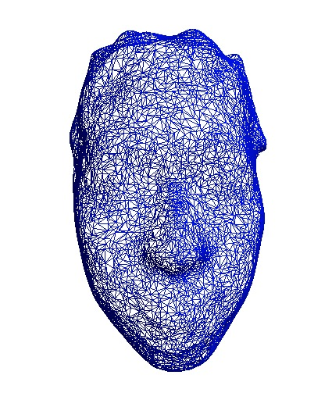
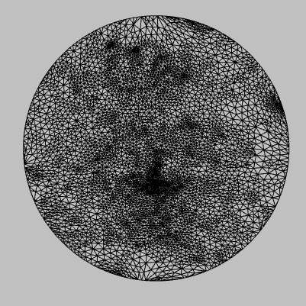
Pre-processing
1.Modeling
2. Extract face
3.Tutte Embedding

Slide 5
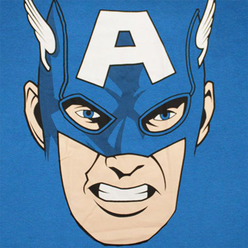
Next, Texture Mapping?
Method 1 – Direct Mapping
→
→
Coordinate mapping
Index mapping

Slide 6
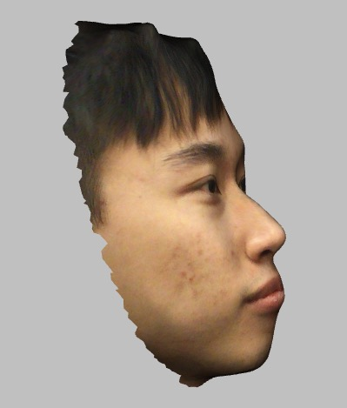
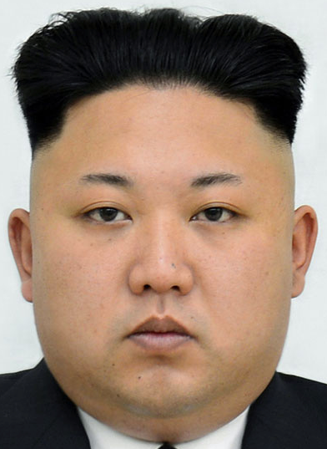
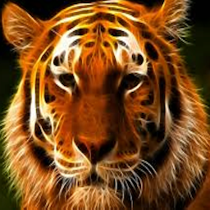
Result 1 – Direct Mapping

Slide 7
Result 1
This seems not bad because General Kim and our model have similar facial structures
However, tiger’s nose, mouth are not in place

Slide 8
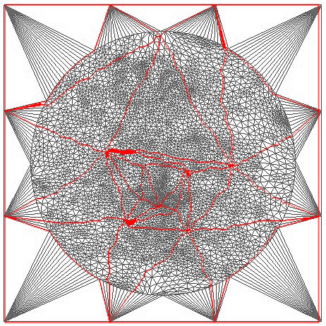
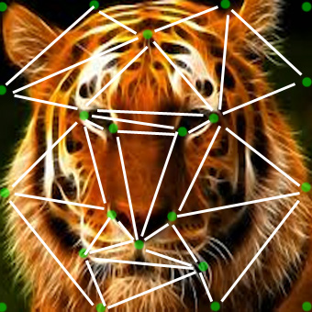
To avoid misplacing –
Match facial regions
Tiger
Face
Human
Face
mapping human’s forehead to tiger’s forehead
human’s face to tiger’s face
human’s nose to tiger’s nose

Slide 9
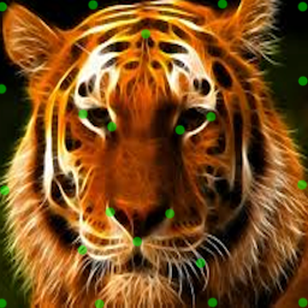
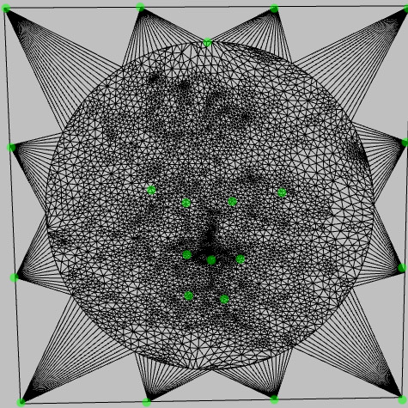
Match facial regions
Identify regions- Constraint points
Human
Face
Tiger
Face
1
2
4
3
1
2
3
4
1
2
3
4

Slide 10
2 Construct regions from constraint points
-Triangulation
Tiger
Face
Human
Face

Slide 11
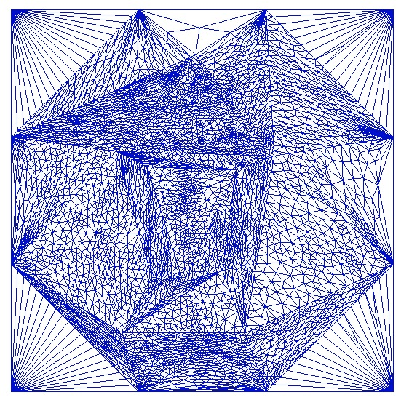
2 Adding constraints to mapping process
Tiger
Face
Human
Face
By Tutte embedding, we “stuff” human’s face vertices into tiger’s corresponding face regions

Slide 12
Next, texture mapping?
→
→
Coordinate mapping
Index mapping

Slide 13
Result 2 Constrained mapping
Result 1
Direct mapping
Pros: Eyes & nose are in place
Cons: Distorted (Tutte
Embedding’s fault)
Pros: Smooth
Cons: Eyes & nose not in place

Slide 14
2.Some interesting algorithms
- Tutte Embedding
- Triangualtion
- Floodfill (original)
- Texture Mapping

Slide 15
2.Some interesting algorithms
- Tutte Embedding
- Triangualtion
- Floodfill (original)
- Texture Mapping

Slide 16
2.Some interesting algorithms
- Tutte Embedding
- Triangualtion
- Floodfill (original)
- Texture Mapping

Slide 17
2.Some interesting algorithms
- Tutte Embedding
- Triangualtion
- Floodfill (original)
- Texture Mapping

Slide 18
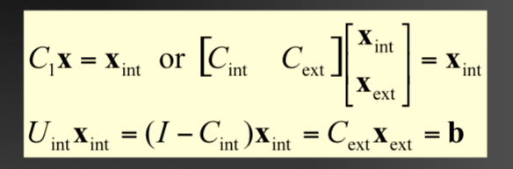
optimization

Slide 19
Task Distribution
Qiao C.
- Convert 3D model to .smf format
- Extract face from 3D model
- Tutte embedding 1 (from 3D to 2D)
- Virtual bounding
- Provide constraint points
- Tutte embedding 2 (“stuff” vertices into tiger’s face)
- Idea of using floodfilling to construct face regions
Chauncey L.
Chong G.

Slide 20
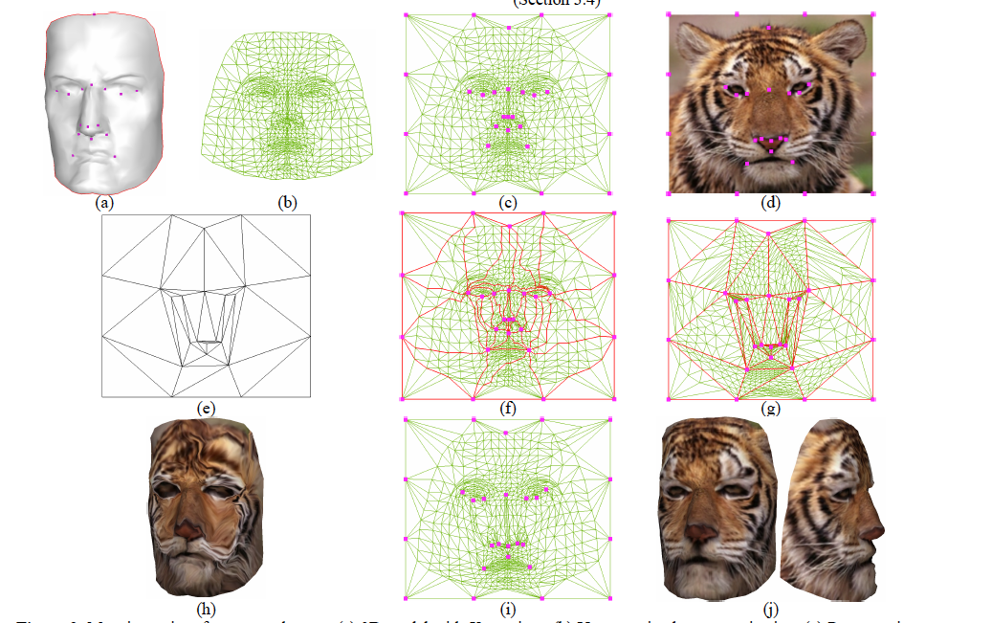
Acknowledgement
Director: Richard Zhang, Computing Science Department of Simon Fraser University
Matchmaker: Constructing Constrained Texture Maps
Vladislav Kraevoy Alla Sheffer Craig Gotsman
Computer Science Department, Technion-Israel Institute of Technology

